Slide 1

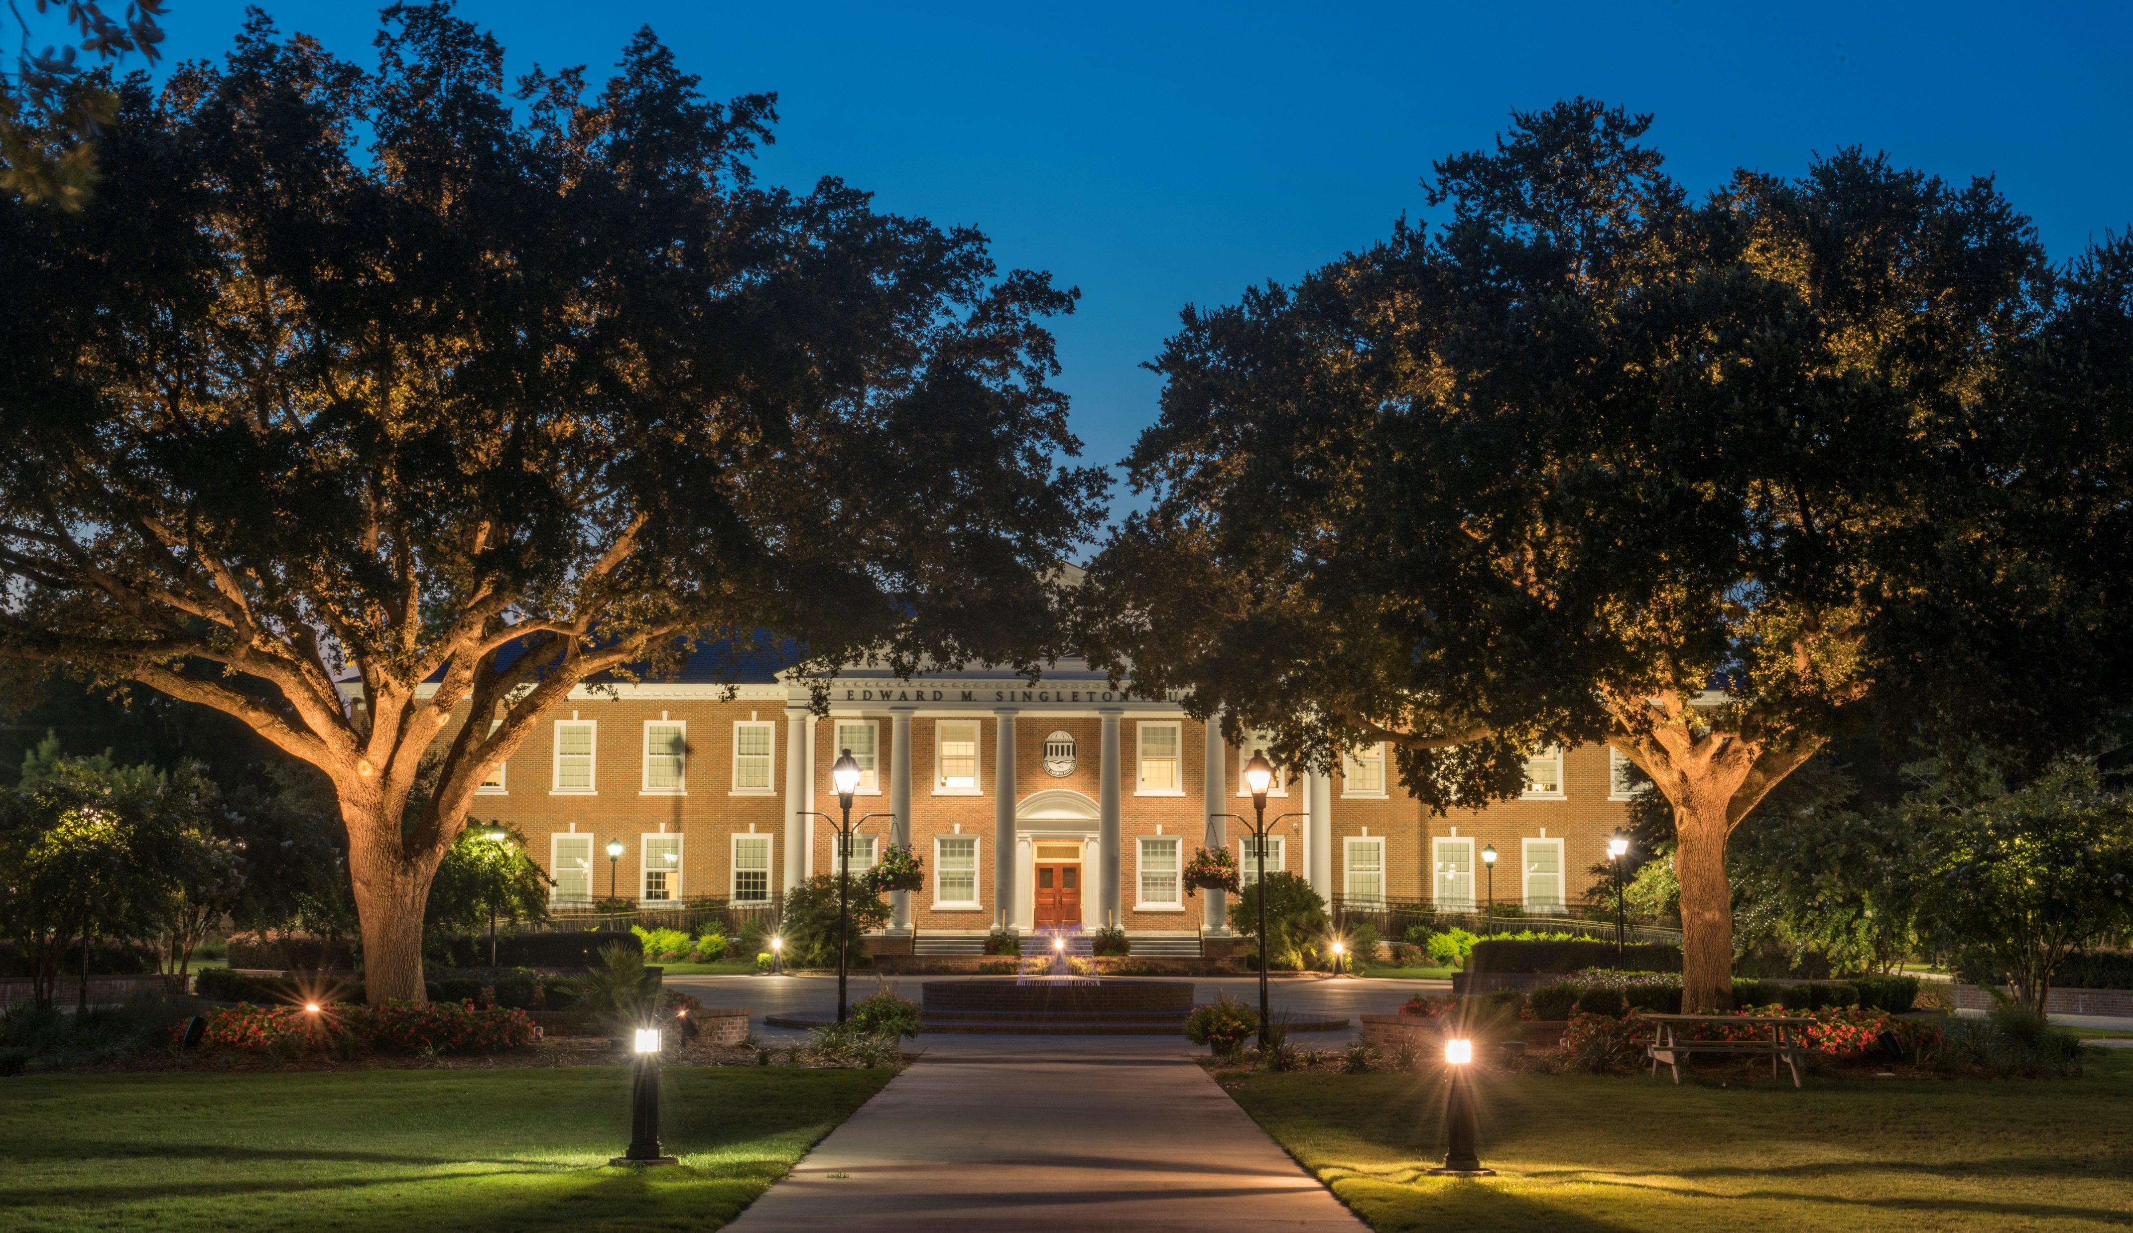
South Carolina House of Representatives
Higher Education and Technical Colleges Subcommittee
Budget Request Fiscal Year 2022-2023
January 19, 2022

Slide 2
Agency Attendees
Michael T. Benson, D.Phil.
President and Professor of History
Daniel J. Ennis, Ph.D.
Executive Vice President for Academic Affairs/Provost
David A. Frost, CPA
Senior Vice President for Finance and Administration/CFO
Brant Branham
Governmental Affairs Director
Julianne Cooke
Director of Budget and Capital Projects

Slide 3
Covid-19 Update
Coastal Carolina University received the following federal COVID-19 funding:
Purpose | Allocation |  | Balance (as of 11/30/21)
 | Institution | Grants to Students | Institution | Grants to Students
CARES Act Higher Education Emergency Relief Fund (HEERF) | $5,027,174 | $5,027,174 | $0 | $0
CRRSAA Higher Education Emergency Relief Fund (HEERF II) | $10,388,741 | $5,027,173 | $0 | $0
American Rescue Plan Higher Education Emergency Relief Fund (HEERF III) | $13,493,270 | $13,600,934 | $7,840,353 | $0
Total | $28,909,185 | $23,655,281 | $7,840,353 | $0
Federal funds are being utilized pursuant to the requirements of each of the Higher Education Emergency Relief Funds.

Slide 4
Covid-19 Update
Coronavirus Relief Funds (CRF)
In addition to funding received directly from the federal government, the University also applied for Coronavirus Relief Funds (CRF) through the State of South Carolina and recovered $14,177,500 in pandemic related expenses.
As a recipient of over $14 million in CRF, Coastal Carolina University underwent a monitoring and compliance review to ensure that:
  the federal funding was used for authorized purposes
  compliance with Federal statutes and regulations
  that the terms and conditions of the funding were met
The review was conducted by Nan McKay and Associates, Inc., an independent firm, at the request of the South Carolina Department of Administration.
Nan McKay reported no findings or areas of noncompliance.

Slide 5
Appropriations History
Year | Recurring | Non-Recurring/Capital | Other Funds | Federal Funds | Total Authorized Spending
FY 2019 | 16,482,897 | 5,042,674 | 211,457,613 | 21,000,000 | 253,983,184
FY 2020 | 16,482,897 | - | 211,457,613 | 21,000,000 | 248,940,510
FY 2021 | 19,336,981 | 13,899,283 | 211,457,613 | 21,000,000 | 265,693,877

Slide 6
2021-2022 Projected Revenue
Total: $259,626,209

Slide 7
2021-2022 Projected Expenses
Total: *$256,951,523
*Excludes additional pension expense required under GASB.
*Projected expenses exceed spending authorization due to receipt of HEERF III federal funds; therefore form BD-100 will be submitted to request increased authority to spend.

Slide 8
Recurring Requests
Priority | Request | Amount Requested | FTEs Requested | Description of Request
1 | University Advising | $1,423,463 | 16.00 | University Advising guides students through their degree program, assisting them in becoming more integrated into the University and forming connections between their coursework and career goals. The unit is made up of five advising centers, a student athlete academic services unit, and a peer leader program which aims to provide a student mentor for all incoming freshmen. General Fund appropriations would support the expansion of the University Advising department, specifically 14 additional academic advisors whose primary responsibility would be the consistent advisement of all students, a director for the newly formed Spadoni College of Education and Social Sciences, and a learning specialist to support at-risk student athletes.
2 | Coastal Student Success Center | $776,525 | 9.00 | The Coastal Student Success Center plays an integral role in assisting students improve academically by providing academic coaching through the Academic Coaching Experience Department, tutoring through the Math Learning Center and the Writing Center, as well as peer mentoring. Recurring appropriations would allow the University to hire 9 new FTE positions to fully staff and expand Center offerings to better support students in developing skills and strategies to enhance their academic and personal performance.
3 | Information Technology Infrastructure and Security | $215,600 | 2.00 | The University places utmost importance on protecting the safety, integrity and security of statewide public resources, data, infrastructure and citizens including timely response to emergencies, disasters and emerging threats. General Funds are requested to improve the educational preparedness of employees in an ever-changing technology environment and daily new threats, as well as, educate students against threats and identity theft. 2 new FTE positions are requested to increase response time to threats and outages.
Total Recurring Requests |  | $2,415,588 | 27.00

Slide 9
Non-Recurring Request
Priority | Request | Amount Requested | Description of Request
5 | Information Technology Infrastructure and Security | $3,344,137 | The University places utmost importance on protecting the safety, integrity and security of statewide public resources, data, infrastructure and citizens including timely response to emergencies, disasters and emerging threats. General Funds are requested to upgrade current infrastructure systems and add security to protect against ransomware. $ 324,000 - Dell Cyber-vault backup solution $ 43,000 - Dell Storage Resource Manager (SRM) License and configuration $ 227,137 - CISCO Firewall 4112 upgrade with management console and RAM upgrade $ 800,000 - Web Application Firewalls (WAF) upgrade $ 100,000 – Addition of 4 Blade servers $1,850,000 - WIFI campus network upgrade and enhanced coverage All items listed above will enhance the security of the University systems, financial and student data. This will also put the University in a position to be able to recover in case of a successful ransomware attack.

Slide 10
Capital Requests
Priority | Request | Amount Requested | Description of Request
4 | Elevator Enhancements | $990,000 | 6 elevators on campus are in need of replacement. There is a single elevator in each building and each elevator is original to the building. Due to their age, parts have become obsolete and are difficult and expensive to source. Building ___Constructed Jackson Student Center 1978 Wheelwright Auditorium 1979 Wall Building 1993 Prince Building 1994 Ingle Hall 1998 Eaglin Hall 2000
6 | Shift Western End of University Boulevard | $7,400,000 | Shift approximately 2,100 feet of the western end of University Blvd southward to the edge of campus. The shift would: Permit expansion of the intercollegiate athletic complex, allowing for construction of the proposed Indoor Multi-purpose playing facility and the proposed Exercise Science and Human Performance Facility. Alleviate the concentration of pedestrians on/near main campus thoroughfare on game days. Draw the intersection of University Blvd with SC 544 closer to University Place residential complex and YY parking lot allowing safer and more convenient pedestrian and bicycle access.
7 | Exercise Science and Human Performance Facility | $32,000,000 | Construct 62,000 sq ft instructional facility for exercise and sport science programs and recreation and sport management programs. 1st and 2nd floors will be devoted to educational programming, including classrooms, labs and administrative/support space. Will serve over 1,000 students in exercise/sport science and recreation/sport management majors. 3rd floor will contain coaches offices, meeting space and suite space will overlook Brooks Stadium.

Slide 11
Other Funds Requests
Coastal Carolina University has no requests for Other Funds for FY 2022-2023.

Slide 12
Federal Funds Request
Coastal Carolina University has no request to increase federal funds authorization for FY 2022-2023.

Slide 13
FTE Request
Coastal Carolina University has no request for additional Other Funded FTEs in FY 2022-2023.
Proviso 11.14. (CHE: Other Funded FTE Revenue) When institutions of higher learning request additional other funded full-time equivalent positions, the Executive Budget Office shall inform the Commission on Higher Education of its decision regarding the request and whether or not sufficient revenues exist to fund the salary and fringe benefits for the positions.

Slide 14
Provisos
Coastal Carolina University has no proviso requests in FY 2022-2023.

Slide 15
Tuition Mitigation
Coastal Carolina University is committed to keeping tuition affordable for students and their families, especially in-state students. The University would be very appreciative of available funding to offset inflationary and mandated cost increases, thereby mitigating against tuition increases.
Tuition Mitigation Calculation
Total Authorized Budget | $251,794,594
Less: Federal Authorization | ($21,000,000)
Less: Auxiliary Authorization | ($17,150,000)
 | $213,644,594
Higher Education Price Index (HEPI) – 2.7% increase | $5,768,404

Slide 16
Capital Renewal Needs
Based on the Fall 2020 Building Condition Survey, there are 31 buildings on Coastal Carolina University’s campus with a condition rating less than 80%.
To arrive at an estimated restoration cost:
Reduced condition rating by 2% to allow for additional year of deterioration
Increased restoration cost by 5% to allow for inflation
It would cost $30,476,000 to bring all facilities to an 80% condition, excluding residence halls, as the revenue produced by University Housing funds the maintenance of residence hall facilities.

Slide 17

Appendix

Slide 18
Student Enrollment
Undergraduate and Graduate Enrollment | Fall 2020 | Fall 2021 | 1-year change
Total Headcount | 10,118 | 10,473 | 3.5%
Total FTE | 9,527 | 9,895 | 3.9%
Student Credit Hours | 141,880 | 147,359 | 3.9%

Slide 19
Student Enrollment

Slide 20
Student Enrollment

Slide 21
Student Enrollment
11%
19%
41%
7%

Slide 22
Student Enrollment
Coastal Carolina University accepts all qualified, in-state students who apply. As a means of holding in-state tuition down, out-of-state tuition differential subsidizes costs.

Slide 23
Graduation Data
Source: http://www.studentachievementmeasure.org
Notes:
Outcomes for students starting at CCU Fall 2013 by summer 2019 (six years)

Slide 24
Tuition & Fees per Semester

Slide 25
2021-2022 Tuition & Fee Schedule
Undergraduate Fees per Semester (12-18 credit hours) | Resident | Non-resident
Base Academic Fee | $4,910 | $12,787
Athletics | $295 | $295
Student Activity | $20 | $20
Debt Service | $355 | $355
Renovation Reserve & Plant Expansion | $150 | $150
Technology | $90 | $90
Total Tuition & Required Undergraduate Fees | $5,820 | $13,697
Graduate Fees per Credit Hour | Resident | Non-resident
Base Academic Fee | $571 | $1,075
Debt Service | $12 | $12
Renovation Reserve & Plant Expansion | $10 | $10
Technology | $5 | $5
Total Tuition & Required Graduate Fees | $598 | $1,102

Slide 26
2021-2022 Tuition, Room and Board
Full-time Tuition, Room and Board per Semester | 2020-2021 |  | 2021-2022 |  | $ Change |  | % Change
 | Resident | Non-resident | Resident | Non-resident | Resident | Non-resident | Resident | Non-resident
Tuition | $5,820 | $13,697 | $5,820 | $13,697 | $0 | $0 | 0.00% | 0.00%
Housing (Double Occupancy) | $3,185* | $3,185* | $3,185* | $3,185* | $0 | $0 | 0.00% | 0.00%
Basic Unlimited Meal Plan | $1,750 | $1,750 | $1,750 | $1,750 | $0 | $0 | 0.00% | 0.00%
Total Tuition, Room and Board | $10,755 | $18,632 | $10,755 | $18,632 | $0 | $0 | 0.00% | 0.00%
*Reflects a $75 per semester rebate to students living in University Housing.

Slide 27
2020-2021 Scholarships & Grants
Source | Award Count (Duplicated) | Dollars
Federal Grants
Pell Grant | 2,738 | $ 14,352,158
SEOG | 642 | $ 516,358
College Work Study | 310 | $ 457,636
TEACH Grant | 19 | $ 74,351
HEERF II | 5,887 | $ 5,159,500
Total Federal | 9,596 | $ 20,560,003
State Scholarships & Grants
SC Need Based Grant | 1,389 | $ 1,461,881
LIFE Scholarship/CTP for LIFE | 1,846 | $ 9,277,522
HOPE Scholarship | 382 | $ 953,640
Palmetto Fellows Scholarship | 147 | $ 1,103,432
SC Air & National Guard Grant | 44 | $ 168,186
SC Teaching Fellows | 56 | $ 306,190
Total State | 3,864 | $13,270,851
Institutional Scholarships
CCU Institutional (non-athletic) | 4,978 | $ 6,930,223
CCU Athletic | 417 | $ 4,586,422
Total Institutional | 5,395 | $11,516,645
External Scholarships | 743 | $ 2,701,438
TOTALS Duplicated count | 19,598 | $48,048,937
Unduplicated count | 6,760
Notes:
Added TEACH Grants as it is in the GL as a federal scholarship; however, according to Dawn, many students do not remain eligible and the grant becomes a direct loan.

Slide 28
Outstanding Debt per Proviso 11.16
Bond Issue/Type/Date | Amount of Initial Principal Debt | Amount of Remaining Debt as of 11/1/21 | Issued Date | Final Maturity | Purpose of Bond Issue
Revenue Bonds
Series 2017 - Higher Education Rev Bonds | $6,766,591 | $3,936,405 | 5/1/2017 | 6/1/2026 | Refinanced Series 2006 Ref Revenue Bonds - Housing
Series 2016 - Higher Education Rev Bonds | $22,415,000 | $19,160,000 | 11/23/2016 | 6/1/2041 | Brooks Football Statidum Expansion
Series 2015 - Higher Education Rev Bonds | $87,020,000 | $75,245,000 | 2/1/2015 | 6/1/2042 | Acquisition of University Place (2,079 beds)
Series 2014 - Higher Education Rev Bonds | $35,480,000 | $31,520,000 | 6/1/2014 | 6/1/2044 | Phase II of Student Housing (624 beds)
Series 2013 - Higher Education Rev Bonds | $54,705,000 | $45,360,000 | 2/1/2013 | 6/1/2040 | Phase I of Student Housing (650 beds)
Series 2012 – Refunding Rev Bonds | $6,147,000 | $2,413,000 | 6/1/2012 | 6/1/2026 | Refinanced 1999 Ref Revenue Bonds - Housing
Total Revenue Bonds | $212,533,591 | $177,634,405
General Obligation State Institutional Bonds
Series 2016E – State Institution Bonds | $10,025,000 | $6,415,000 | 10/1/2016 | 4/1/2027 | Refinanced 2002D and 2006C Institutional Bonds
Total General Obligation Bonds | $10,025,000 | $6,415,000

Slide 29
Employees
The University has 2,779 employees, including students, as of December 2021 with an annual salary expense of $105.5 million.
499 full-time faculty
171 part-time faculty
908 full-time staff
95 part-time staff
1,106 undergraduate and graduate student employees
FTE | Authorized | Vacant
State FTEs | 197.74 | 25.50
Federal FTEs | 9.62 | 1.75
Other FTEs | 1,264.69 | 217.62
Total FTEs | 1,472.05 | 244.87

Slide 30
Employee Demographics

Slide 31
University Leadership Demographics
Total Minority: 27%
Total Female: 18%
Total Minority: 19%
Total Female: 41%

Slide 32
2020-2021 4% Tuition Waivers & Abatements
 |  | 2018-2019 |  |  | 2019-2020 |  |  | 2020-2021
Name of Program | Level | Students | Residents | Non-Residents | Students | Residents | Non-Residents | Students | Residents | Non-Residents
4% Waivers | Freshmen | 1,337 | 1,313 | 24 | 741 | 704 | 37 | 770 | 754 | 16
 | Sophomore | 1,178 | 1,140 | 38 | 530 | 512 | 18 | 610 | 597 | 13
 | Junior | 1,120 | 1,063 | 57 | 465 | 454 | 11 | 571 | 552 | 19
 | Senior | 1,057 | 1,043 | 14 | 330 | 320 | 10 | 416 | 405 | 11
 | Other | 73 | 73 | 0 | 45 | 45 | 0 | 45 | 43 | 2
 | Total | 4,765 | 4,632 | 133 | 2,111 | 2,035 | 76 | 2,412 | 2,351 | 61
Abatement Full | Freshmen | 135 | 0 | 135 | 147 | 2 | 145 | 189 | 0 | 189
 | Sophomore | 125 | 0 | 125 | 142 | 0 | 142 | 143 | 0 | 143
 | Junior | 115 | 0 | 115 | 143 | 0 | 143 | 134 | 0 | 134
 | Senior | 122 | 0 | 122 | 150 | 1 | 149 | 156 | 0 | 156
 | Other | 0 | 0 | 0 | 2 | 0 | 2 | 3 | 0 | 3
 | Total | 497 | 0 | 497 | 584 | 3 | 581 | 625 | 0 | 625
Abatement Partial | Freshmen | 1,204 | 0 | 1,204 | 1,396 | 4 | 1,392 | 1,500 | 0 | 1,500
 | Sophomore | 708 | 0 | 708 | 790 | 3 | 787 | 972 | 0 | 972
 | Junior | 496 | 0 | 496 | 552 | 4 | 548 | 678 | 0 | 678
 | Senior | 451 | 0 | 451 | 486 | 2 | 484 | 579 | 1 | 578
 | Other | 0 | 0 | 0 | 1 | 0 | 1 | 0 | 0 | 0
 | Total | 2,859 | 0 | 2,859 | 3,225 | 13 | 3,212 | 3,729 | 1 | 3,728
Pursuant to Section 59-101-620, Coastal Carolina University limits educational fee waivers to no more than four percent of our undergraduate students. The calculation is done using 4% of undergraduate student fee revenue. The increase in 4% waivers in 2018-2019 is primarily due to a $100 tuition rebate per semester that was awarded to each full-time, in-state student.
Notes:
According to Wendy in prior year, non-resident could reflect in 4% waiver if they receive yellow ribbon match, are OV status, or receive certain student activity stipend.

Slide 33
Capital Projects
Project Number | Project Name | Source of Funding | Approved Budget | Balance | Status
9598 | Information Technology Wiring Upgrades | Gift In Kind | $619,000 | $158,400 | Active
9609 | Soccer Complex Construction | Gifts | $5,000,000 | $4,918,020 | Active
9615 | Library Learning Complex | Capital Reserve Fund, Penny Tax | $29,800,000 | $28,088,002 | Active
9616 | Library Renovation-Phase I | ICPF, Gifts, Penny Tax | $150,000 | $0 | Active
9618 | Eaglin Residence Hall Renovation | Auxiliary Renovation Reserve | $5,000,000 | $4,963,005 | Active
Open Projects per SPIRS Report |  |  | $6,181,500 | $38,127,427

Slide 34
Current Maintenance Projects
Project Number | Project Name | Source of Funding | Budget
7601/02 | Interior/Exterior Refurbishment | E&G Renovation Reserve | $828,728
7603/04 | Infrastructure Improvements & Communications Projects | E&G Renovation Reserve | $769,721
7605/31 | Residence Hall Maintenance & Improvements | Auxiliary Renovation Reserve | $488,850
7606/07/08 | Athletic, Academic & Administrative Facilities Projects | E&G Renovation Reserve | $753,734
7611 | Sands Hall Music Practice Rooms | E&G Renovation Reserve | $750,000
7640 | Central Cooling Expansion | E&G Renovation Reserve | $975,000
7666 | Kearns Hall Renovations | Gift | $375,000
7667 | Intel Lab | E&G Renovation Reserve | $150,000
7669 | Residence Hall Mass Notification System | Auxiliary Renovation Reserve; Grant | $201,947
7671 | Hall of Fame Renovation | E&G Renovation Reserve; Athletics | $165,000
7672 | Maker Space | E&G Renovation Reserve | $150,000
7681 | B&C Building Roof Replacement | Capital Reserves | $685,000
7683 | Practice Field Renovation | Capital Reserves/Student Activities Fee Revenue | $1,068,975
7684/7690/7351 | Chick-Fil-A /Port City Java/Hicks Dining Hall Renovations | Aramark | $2,230,000
7685 | TD Park Underground Piping | E&G Renovation Reserve | $450,000
7686/7692 | Library Compact Shelving/Classroom Renovation | E&G Renovation Reserve | $500,000
7687 | Johnson Auditorium Renovation | E&G Renovation Reserve | $50,000
7688 | Prince Building Renovation | Proviso 118.18 Appropriation | $1,500,000
7689 | Hackler Cart Paths and Curbing | Capital Reserves | $500,000
7691 | Edward Building Roof Replacement | Proviso 118.18 Appropriation | $1,600,000
Active Maintenance Projects |  |  | $14,191,955
The Department of Facilities Planning and Management has compiled a maintenance schedule listing maintenance needs and costs for all campus buildings over a 20-year period, which spans from FY 2016 through FY 2036.

Slide 35
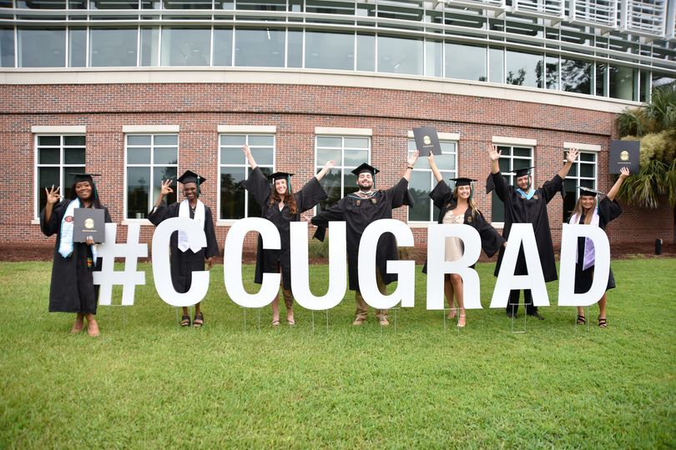
Thank you!

